Slide 1




PASSIVE VOICE
UTN FRVM Lic. Evangelina Cecchel - Lic. Bibiana Fernandez

Slide 2
There are two voices of verbs in English: Active and Passive.
Voice, either active or passive, refers to how verbs are used in sentences. In some sentences, the subject of the sentence performs the action. Consider the following sentence: My mother waters the plants every day. The subject is “My mother”. She performed the action of “watering the plants”. Since the subject is actively doing the action, the sentence is in active voice.
For a sentence to be in passive voice, the subject must be acted upon by the verb: The plants are watered by my mother every day. Now, the subject of the sentence are “the plants”. They are not actively doing anything. Instead, “they are passively being watered by my mother”. In passive voice sentences, some other agent who is not the subject of the sentence performs the action. In our example, “my mother” is the agent. The agent is sometimes omitted altogether. The plants are watered every day.
UTN FRVM Lic. Evangelina Cecchel - Lic. Bibiana Fernandez

Slide 3
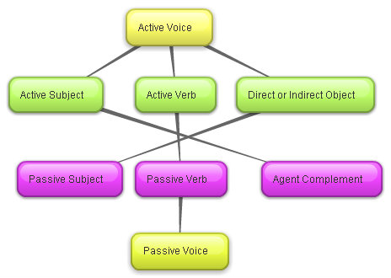
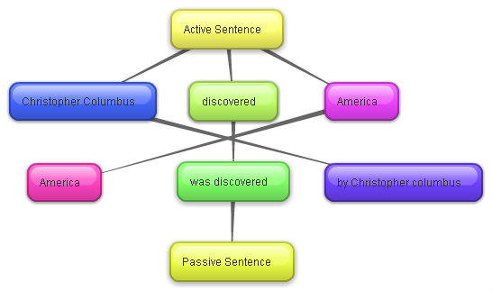
UTN FRVM Lic. Evangelina Cecchel - Lic. Bibiana Fernandez

Slide 4
In the active voice, the subject performs the action of the verb…
I write a story.
Subject + verb + object.
In the passive voice, the subject is acted upon by the verb.
A story is written (by me).
Object which is now the subject + be (in the correct tense) + past participle + (agent)
UTN FRVM Lic. Evangelina Cecchel - Lic. Bibiana Fernandez

Slide 5
In English we use the passive voice for several reasons, all of them are important:
When we don’t know the identity of the agent of the action.
His shop was stolen again.
When it is not important to mention the agent of the action.
The rubbish was taken away by the dustmen this morning.
When we want to avoid mentioning the agent of the action.
A report is given to the authorities.
In all these three cases, the agent is omitted.
When we want to emphasize the object more than the agent of the action by mentioning the object at the beginning of the sentence.
More and more computers are sold every day.
UTN FRVM Lic. Evangelina Cecchel - Lic. Bibiana Fernandez

Slide 6
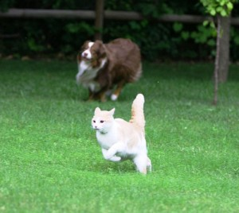
How to Use Passive Voice:
Start the sentence with the subject receiving the action. Remember the subject in passive voice is the object in active voice.
The cat
Next, add the appropriate form of the verb to be, conjugated in the desired tense.
The cat was
Add the main verb in the corresponding tense.
The cat was chased
If the agent is unknown or irrelevant, you are finished with the sentence after you close it with a period. Otherwise, you can identify the agent with a prepositional phrase starting with by that is the complement of the sentence.
The cat was chased by the dog.
UTN FRVM Lic. Evangelina Cecchel - Lic. Bibiana Fernandez

Slide 7
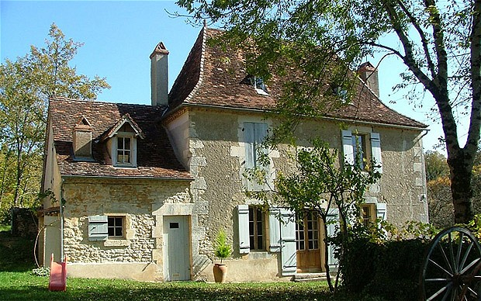
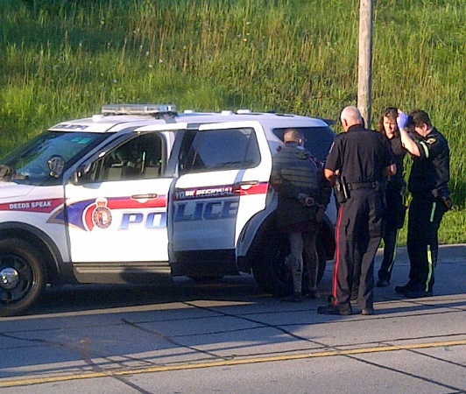
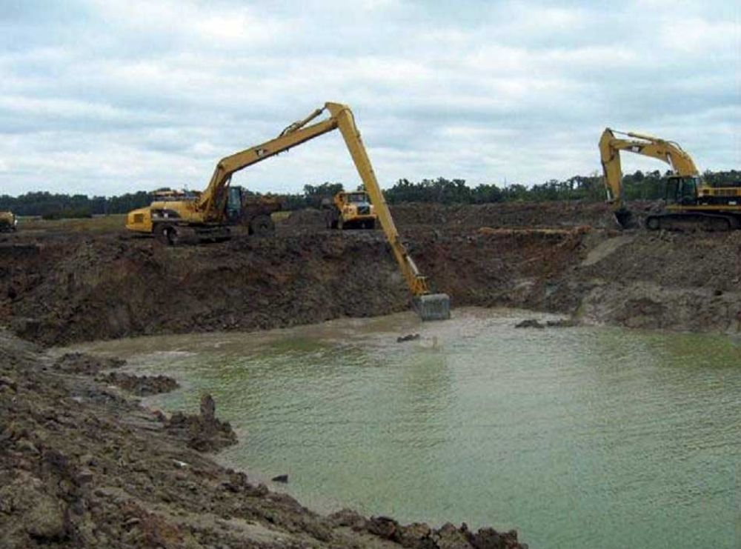

This house was built in the XIX century.
A new bridge will be built next year.
The suspect was arrested yesterday.
She has received a prize.
UTN FRVM Lic. Evangelina Cecchel - Lic. Bibiana Fernandez

Slide 8
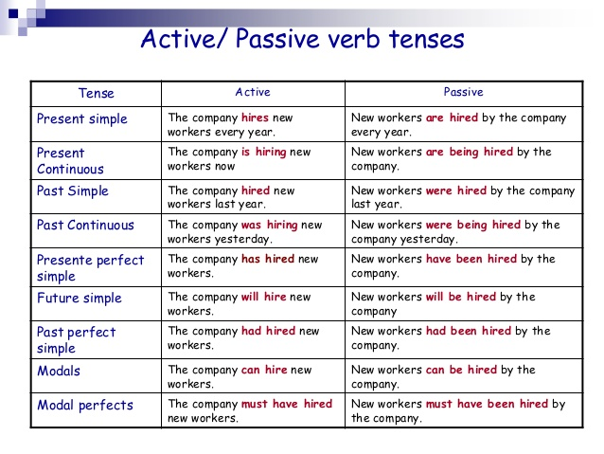
UTN FRVM Lic. Evangelina Cecchel - Lic. Bibiana Fernandez

Slide 9

UTN FRVM Lic. Evangelina Cecchel - Lic. Bibiana Fernandez

Slide 10
Passive Voice:
http://www.ompersonal.com.ar/omgrammar/vozpasiva.htm
http://www.ompersonal.com.ar/INTERMEDIATE/unit12/page2.htm
http://www.ompersonal.com.ar/INTERMEDIATE/unit12/page3.htm
http://www.ompersonal.com.ar/INTERMEDIATE/unit12/page4.htm
http://www.ompersonal.com.ar/ADVANCED/unit10/page5.htm
UTN FRVM Lic. Evangelina Cecchel - Lic. Bibiana Fernandez

